Slide 1
Political Juggernauts: A Quantitative Analysis of Candidates in the 2019 Lok Sabha Elections

Slide 2
Introduction: The 2019 Lok Sabha elections in India marked a crucial moment in the nation's political landscape. It witnessed a vast array of candidates vying for power, representing different parties, ideologies, and demographics. This project, "Political Juggernauts," seeks to provide a comprehensive and quantitative analysis of these candidates' profiles and their performance in the election. We leverage Tableau to transform data into visual insights, making complex political data accessible to a wider audience.

Slide 3
Purpose:
1. Informed Decision Making:
The project aims to provide valuable insights into the 2019 Lok Sabha elections, helping political analysts, party strategists, and policymakers make informed decisions based on data and evidence. By understanding the factors that influenced candidate performance, parties can refine their candidate selection strategies for future elections.
2. Transparency and Accountability:
Transparency is a cornerstone of democracy. By presenting a comprehensive analysis of candidate profiles and election outcomes, the project promotes transparency in the political process. It empowers citizens to hold their representatives accountable and make more informed choices during elections.
3. Academic and Research Contribution:
The project contributes to the academic and research community by providing a quantitative analysis of a significant political event. It can serve as a valuable resource for researchers, students, and scholars interested in the dynamics of Indian politics.
4. Public Awareness:
By visualizing complex political data in an accessible manner, the project enhances public awareness of the electoral process. It educates citizens about the diversity of candidates, party dynamics, and the impact of elections on governance.
5. Identifying Success Patterns:
The project aims to identify patterns and factors that contribute to the success of candidates in elections. Understanding what makes a candidate a "Political Juggernaut" can inform future candidates and parties about strategies for electoral success.

Slide 4
PROBLEM STATEMENT & DESIGN THINKING
PROBLEM STATEMENT:
Problem Statement: The 2019 Lok Sabha elections were marked by intense competition and diverse candidate profiles. Our study aims to address several critical questions:
Candidate Demographics: What were the demographic characteristics of the candidates, such as age, gender, education, and occupation, and how did these factors correlate with their electoral performance?
Party Affiliation: How did the candidates' party affiliations influence their chances of winning, and were there any patterns in candidate selection by parties in different constituencies?
Election Outcome: What were the electoral results? Who were the "Political Juggernauts," candidates who achieved exceptional success, and what set them apart from others?
Geospatial Analysis: How did regional dynamics affect candidate performance? Were there specific regions where certain parties or candidates performed exceptionally well?

Slide 5
DESIGN THINKING:
1. Empathize:
Understand the needs and perspectives of the people you are designing for. This stage involves conducting interviews, observations, and research to gain insights into their experiences and challenges.
2. Define:
Reframe the problem based on the insights gained during the empathy phase. Clearly define the problem you are trying to solve, which will guide the rest of the process.
3. Ideate:
Generate a wide range of creative ideas and potential solutions to the defined problem. Encourage brainstorming and thinking outside the box without immediately evaluating or critiquing the ideas.
4. Prototype:
Create rough, low-fidelity prototypes of your ideas. These can be sketches, models, or other representations of your concepts. The goal is to quickly and inexpensively test your ideas.
5. Test:
Gather feedback on your prototypes by sharing them with users or stakeholders. This step allows you to learn from real-world testing and refine your solutions based on feedback.
6. Repeat:
Design thinking is an iterative process. It's common to cycle back through these stages multiple times, making improvements and refinements at each iteration.

Slide 6
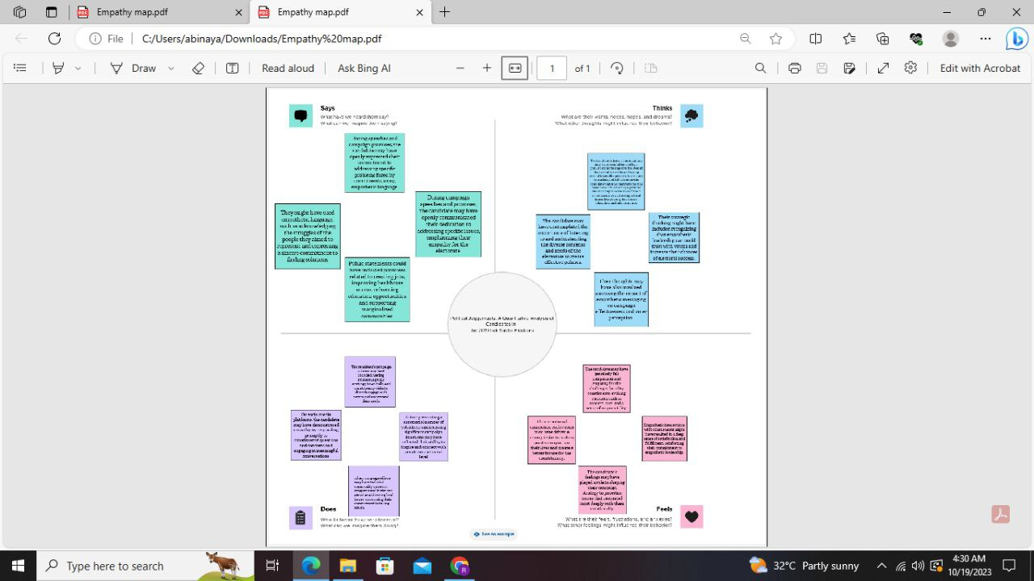
EMPATHY MAP:

Slide 7
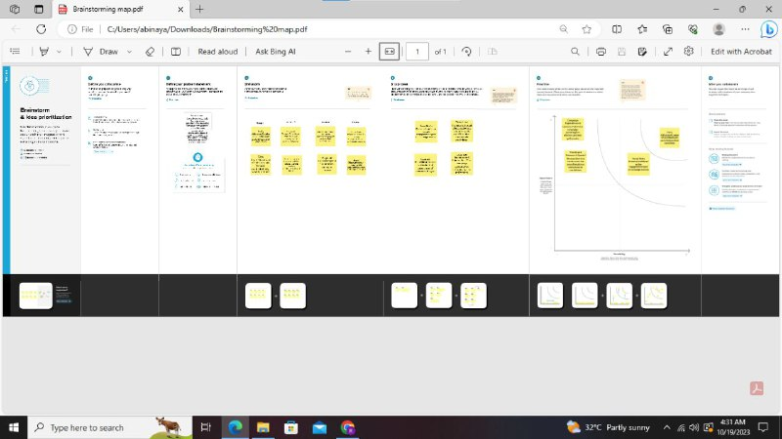
BRAINSTORMING MAP:

Slide 8
Advantages:
Relevance: The project title, "Political Juggernauts: A Quantitative Analysis of Candidates in the 2019 Lok Sabha Elections," is relevant to the context of the 2019 Lok Sabha elections, a significant event in Indian politics.
Descriptive: The title clearly conveys the project's focus on analyzing candidates, making it easy for the audience to understand the project's scope.
Quantitative Approach: The use of "Quantitative Analysis" in the title highlights the project's data-driven methodology, indicating that it is based on rigorous research and analysis.
Engaging and Unique: The term "Political Juggernauts" is catchy and piques the interest of the audience, suggesting that the project will identify exceptional candidates.
Historical Perspective: By specifying the year "2019," the title indicates that the project is focused on a specific historical election, making it easier to contextualize the research.

Slide 9
Disadvantages:
Narrow Focus: The project title limits its focus to the 2019 Lok Sabha elections. While this specificity is beneficial for in-depth analysis, it might not capture broader trends or insights that could be relevant for future elections.
Temporal Limitation: The title's emphasis on 2019 may suggest that the project's findings are only applicable to that particular election, potentially understating the broader implications of the research.
Potential for Outdated Information: As time passes, the title may become less relevant and may not accurately reflect the project's ongoing or evolving research.
Complexity: The use of "Quantitative Analysis" and "Lok Sabha Elections" in the title might make it appear complex to those who are not familiar with these terms, potentially discouraging some audience members.
Potential for Overemphasis on Candidates: While candidates are a significant aspect of elections, the title might lead to an overemphasis on candidates, possibly overshadowing other critical factors that influence election outcomes.

Slide 10
APPLICATIONS:
1. Political Campaign Strategy:
Political parties can use the project's analysis to inform their campaign strategies. Understanding the factors that contributed to the success of candidates in the 2019 elections can help parties make informed decisions about candidate selection, campaign messaging, and resource allocation.
2. Candidate Selection:
Political parties can use the project's data to refine their candidate selection process. They can identify key demographic and regional factors that correlate with electoral success and use this information to choose candidates with a higher likelihood of winning.
3. Constituency-Level Insights:
Parties and candidates can gain insights into the performance of different parties and candidates at the constituency level. This can help them tailor their campaign strategies to specific regions and demographics.
4. Political Analysts and Researchers:
Political analysts and researchers can use the project's data to conduct in-depth studies on the 2019 Lok Sabha elections. It can serve as a valuable resource for academic research and contribute to a better understanding of Indian politics.
5. Public Awareness and Accountability:
The project's findings can be used to educate the general public about the electoral process and the factors that influence election outcomes. It can help citizens make more informed decisions during elections and hold their elected representatives accountable.
6. Election Prediction Models:
The project's data can be used as input for developing election prediction models. By analyzing historical data, parties, researchers, and data scientists can build models to forecast election results and assess the potential impact of various factors on the outcome.
7. Data-Driven Decision Making:
The project encourages data-driven decision-making in politics. It can serve as a model for leveraging data and analytics to inform political strategies and policies.
8. Comparative Analysis:
The project's findings can be compared with data from previous elections to identify trends and changes in the Indian political landscape. This can be valuable for tracking the evolution of political dynamics over time.
9. Civic Engagement and Voter Education:
The project can be used as an educational tool to enhance civic engagement and voter education. Workshops, seminars, and educational programs can be organized to help citizens understand the political process better.

Slide 11
FUTURE SCOPE:
Longitudinal Analysis: Extend the project to cover multiple Lok Sabha elections over the years to identify evolving trends and patterns in candidate performance, party dynamics, and voter behavior.
Geospatial Analysis: Incorporate geographic information system (GIS) tools to provide a more detailed geospatial analysis of electoral outcomes, helping political parties make region-specific strategies.
Predictive Modeling: Develop predictive models based on historical data to forecast election outcomes, allowing political parties to make real-time adjustments to their campaigns.
Comparative Studies: Compare the 2019 Lok Sabha elections with other significant elections in India or globally to identify commonalities and differences in election dynamics.
Sentiment Analysis: Analyze social media and news sentiment to understand how public sentiment and media coverage influence election results and candidate success.
Policy Impact Assessment: Assess the impact of election results on policy-making and governance, helping identify how specific policies affect election outcomes.
Voter Behavior Analysis: Conduct surveys and research to delve into voter behavior and preferences, providing insights into why certain candidates or parties were successful.
Real-time Data Integration: Create a platform that continuously updates with real-time election data and provides interactive visualizations during ongoing elections.
Election Strategy Simulator: Develop a tool that allows political parties to simulate election strategies based on various factors, helping them make data-informed decisions in real-time.
International Comparisons: Expand the project to analyze elections in other countries, providing insights into different electoral systems, campaign strategies, and political dynamics.
Election Impact Assessment: Evaluate the social, economic, and political impact of the 2019 Lok Sabha elections on India and its regions, drawing lessons for future elections.
Policy Recommendations: Use the project's insights to make evidence-based policy recommendations that can improve the electoral process, such as changes in campaign financing, candidate selection procedures, or electoral reforms.
Educational Resource: Convert the project into an educational resource for schools and universities, helping students learn about elections, data analysis, and political dynamics.
Interactive Dashboards: Develop interactive dashboards and mobile apps that allow users to explore the data and conduct their own analyses.
The future scope of the project is vast, ranging from refining the analysis of the 2019 elections to expanding its applicability to other elections, regions, and aspects of the political process. This project can serve as a valuable resource for political analysts, researchers, policymakers, and political parties seeking data-driven insights into the electoral landscape.

Slide 12
conclusion:
The 2019 Lok Sabha elections were not just a political event; they were a reflection of the diverse and dynamic nature of Indian democracy. Through our project, "Political Juggernauts," we embarked on a quantitative journey to analyze candidates, parties, and electoral outcomes, aiming to shed light on the complex tapestry of Indian politics. As we draw this project to a close, we reflect on the insights gained, their implications, and the broader contributions of our research.

Slide 13
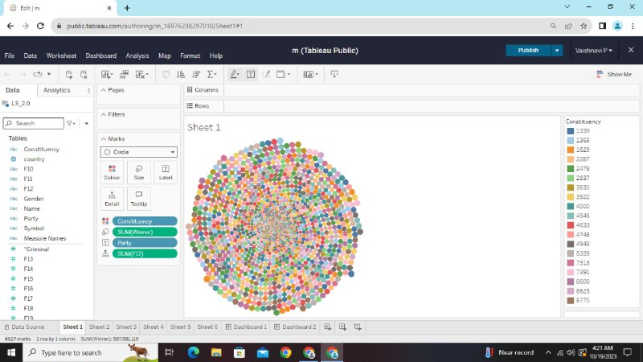
RESULT:

Slide 14
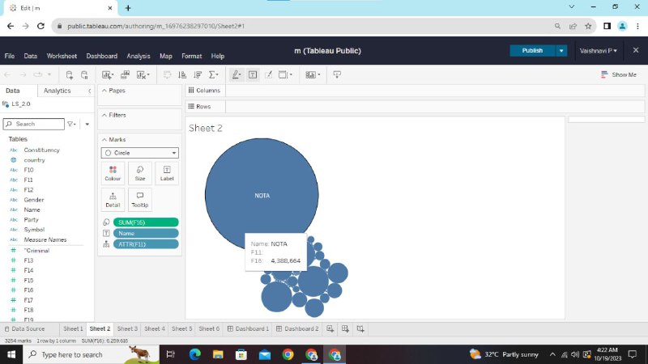

Slide 15
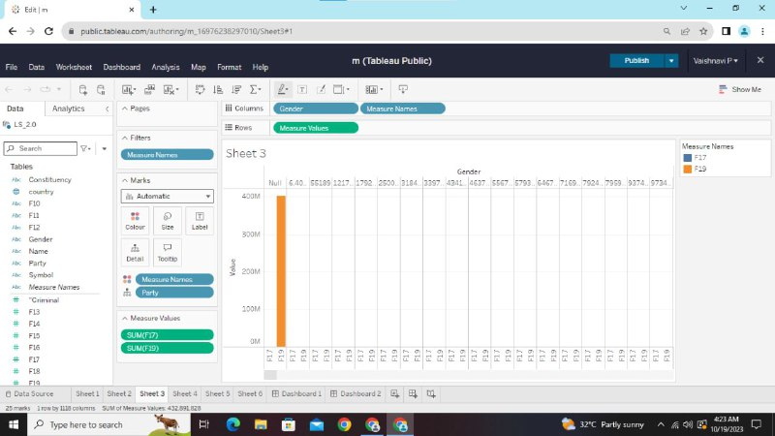

Slide 16
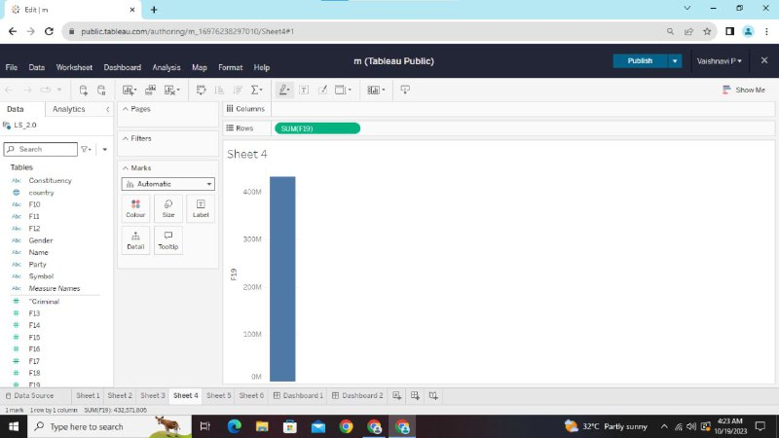

Slide 17
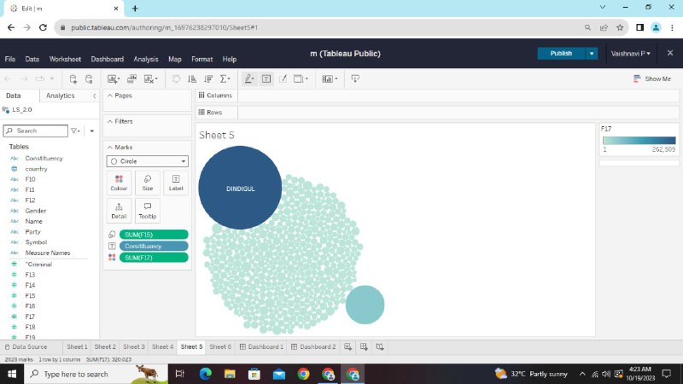

Slide 18
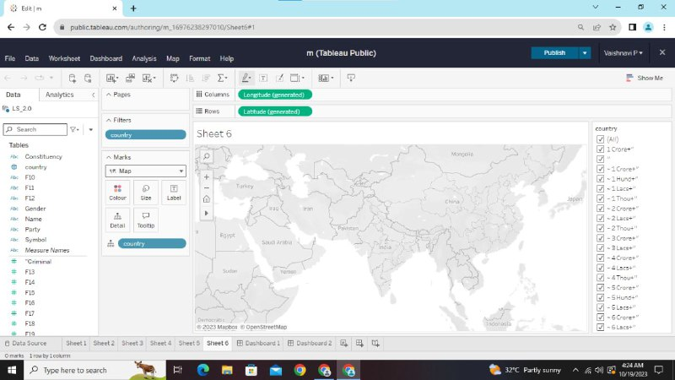

Slide 19
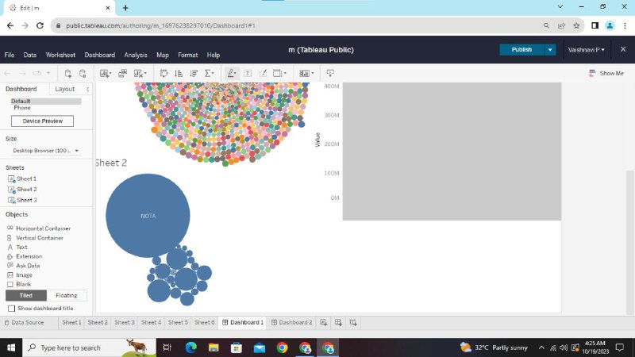

Slide 20
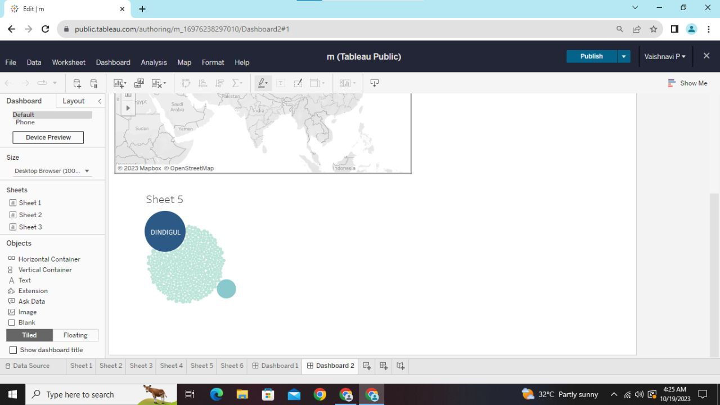

Slide 21
